Slide 1
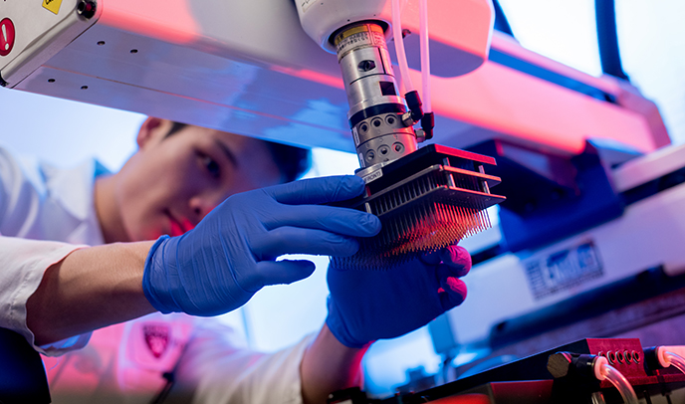
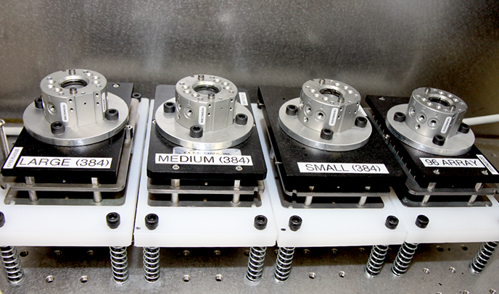
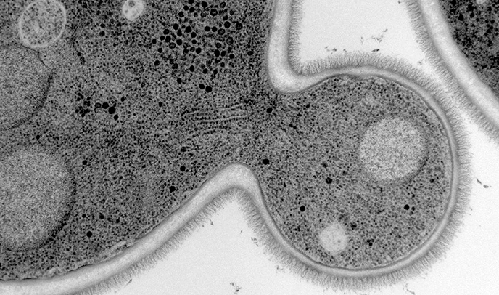
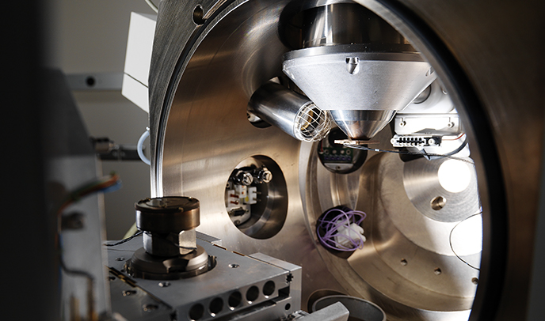
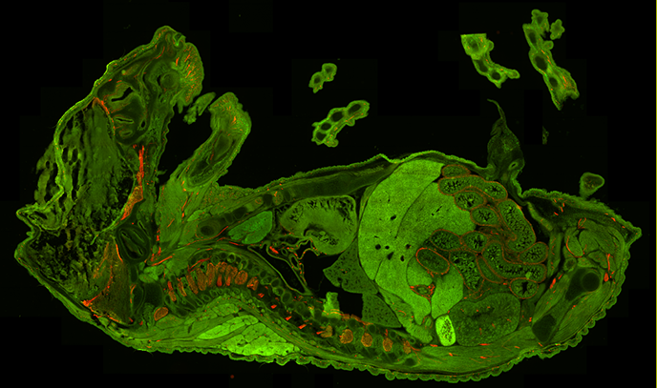
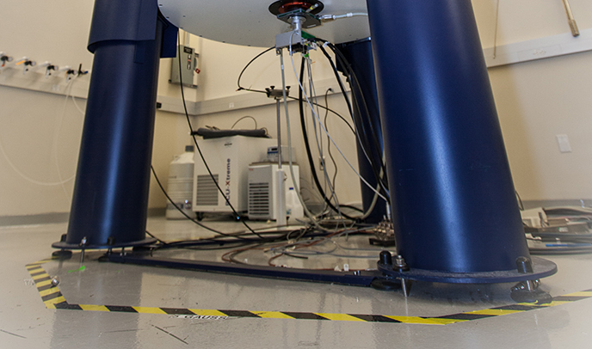


HMS Research Cores Showcase
Poster Session & Reception
Thursday, November 21st
3 - 5 PM
NRB Rotunda
Research Core Facilities provide highly specialized services, equipment, and staff that would otherwise be too expensive for a single laboratory. Attend this event to learn about new technologies and resources available via HMS Cores.
Light Microscopy Electron Microscopy (EM) Small molecule and RNAi screening Image Management and Analysis Flow Cytometry and Cell Sorting NextGen Sequencing Research Instrumentation Design/Fab Microfluidics | Mass Spec NMR Analytical Chemistry Bioinformatics Computing and Software Transgenic Mice Mouse Behavior Single Cell Services
HMS Research Core Facilities
Supporting Innovative Research at Harvard
Core Facilities
https://corefacilities.hms.harvard.edu

